Slide 1
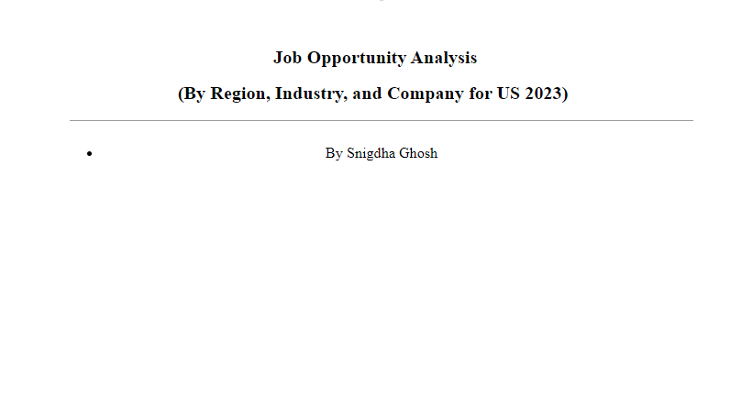
Find the analysis at: SCDATA | GCPS System

Slide 2
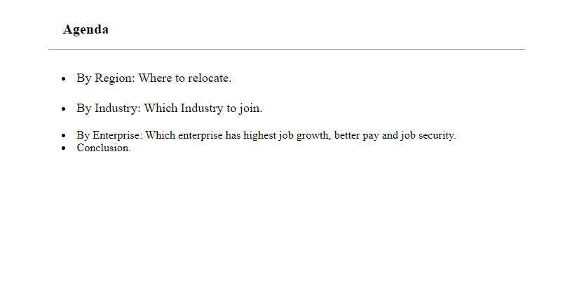

Slide 3
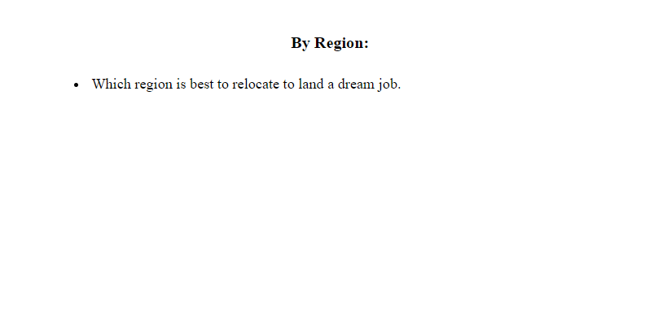

Slide 4
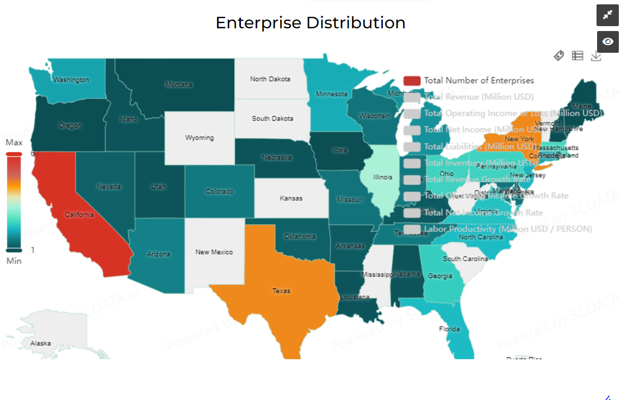

Slide 5
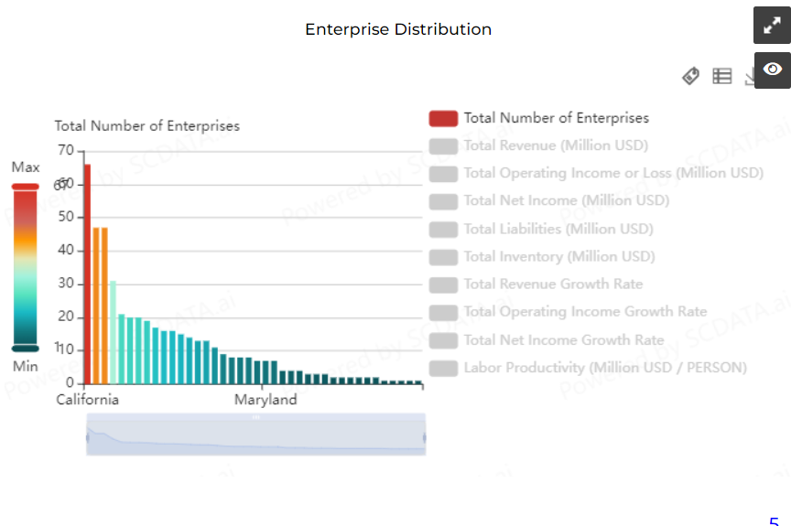

Slide 6
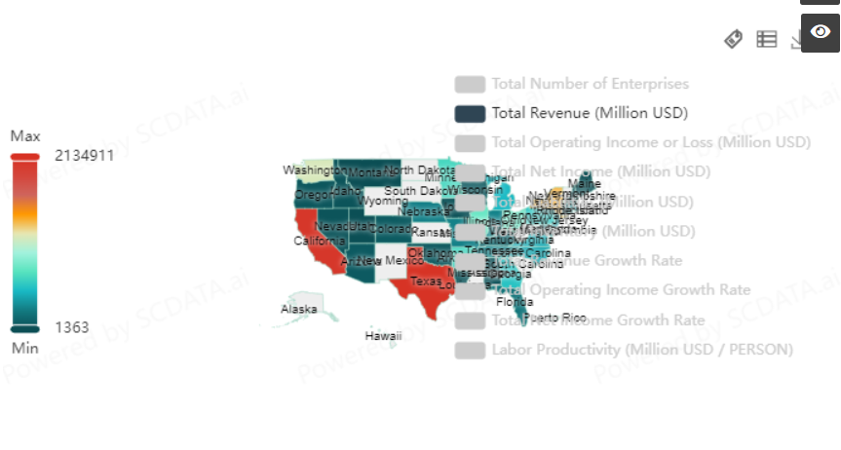

Slide 7
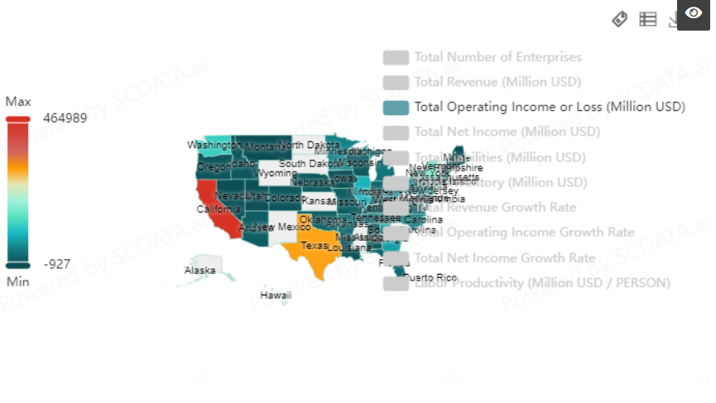

Slide 8
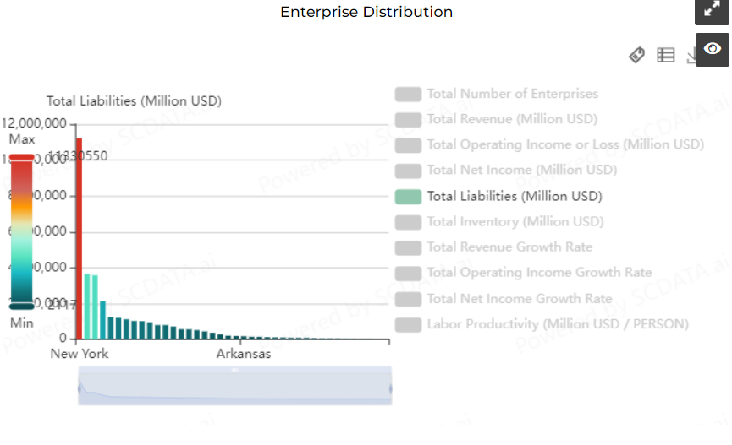

Slide 9
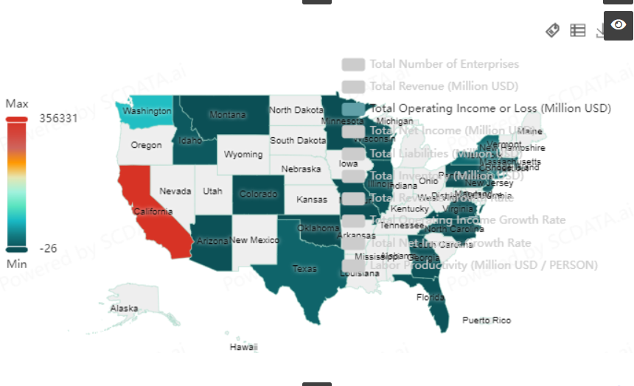
Notes:
Information Technology Sector

Slide 10
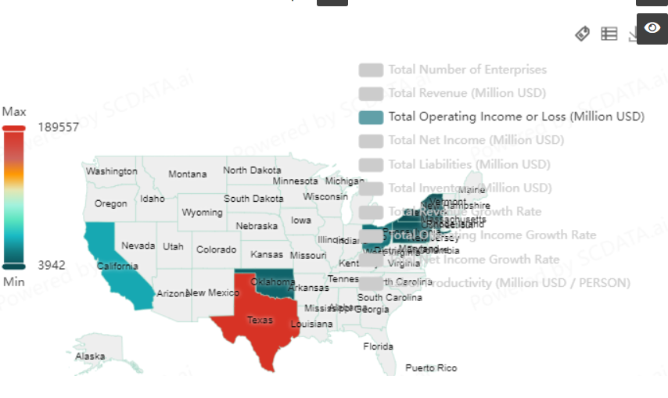
Notes:
Energy Sector

Slide 11
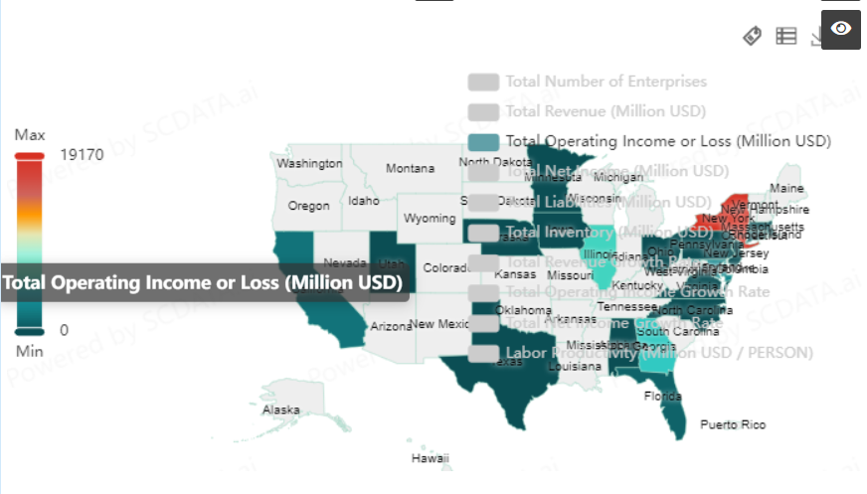
Notes:
Financial Sector

Slide 12
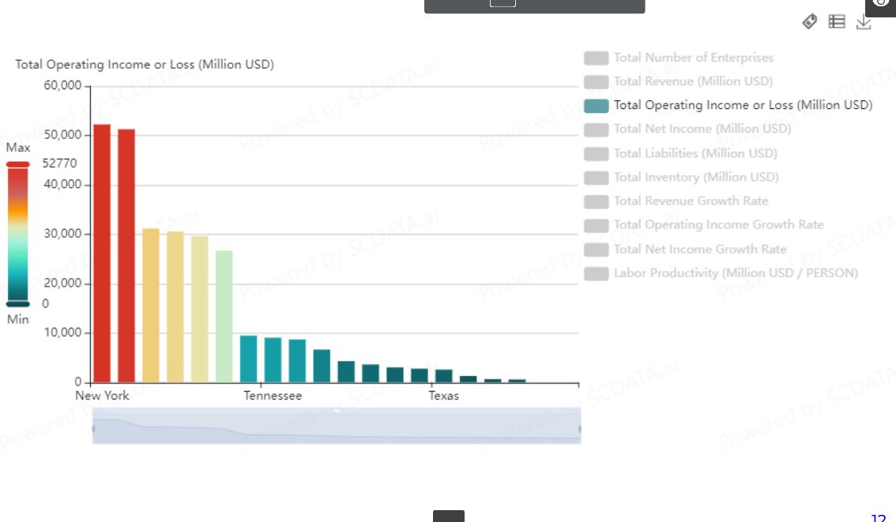
Notes:
Healthcare Sector

Slide 13
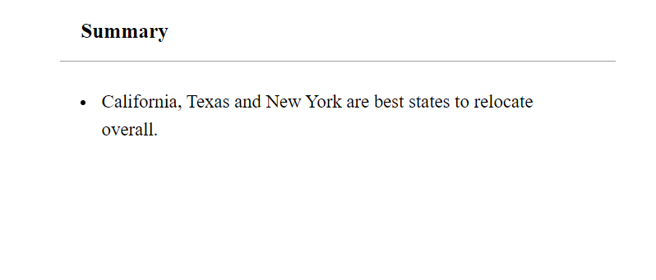
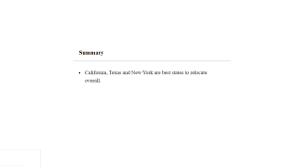

Slide 14


Slide 15
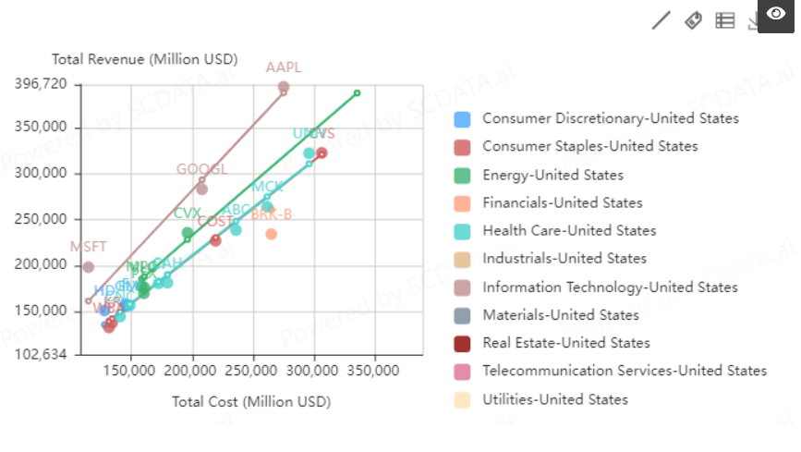

Slide 16
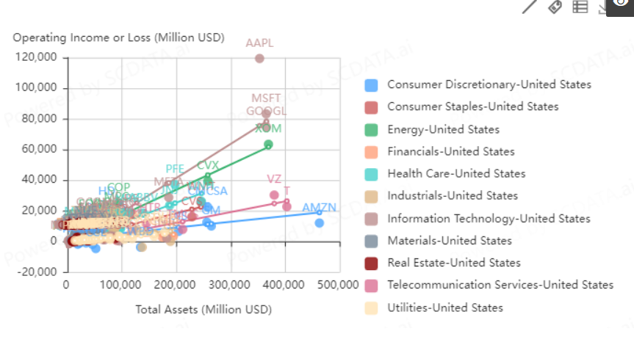

Slide 17
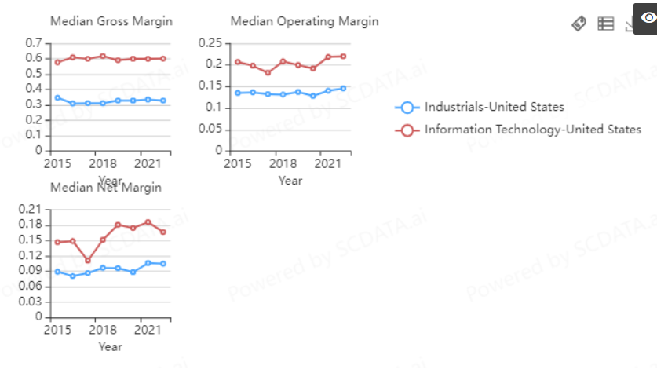

Slide 18
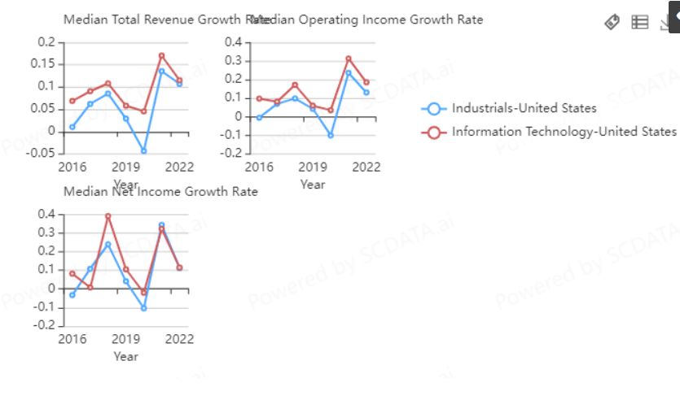

Slide 19
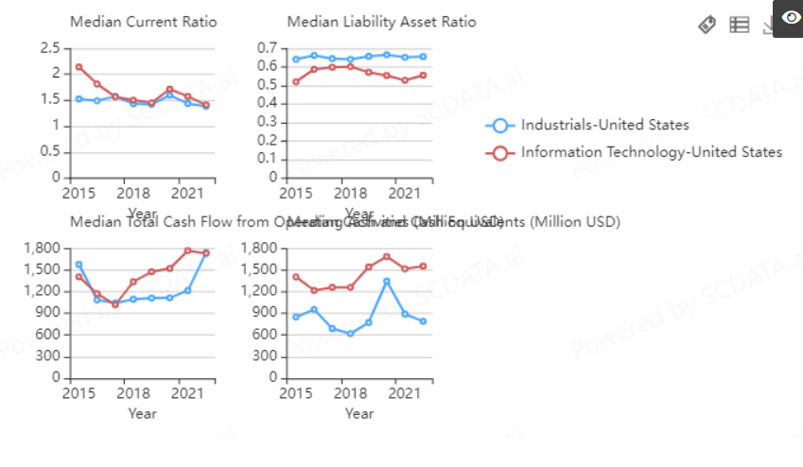

Slide 20
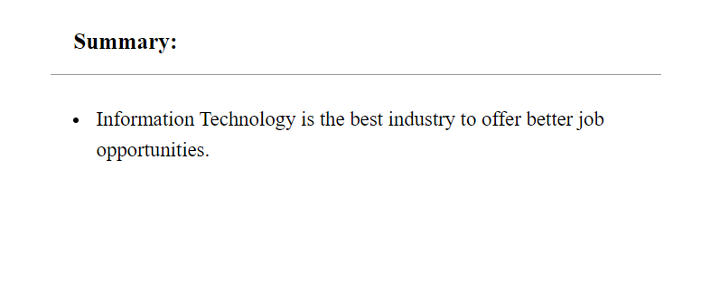

Slide 21
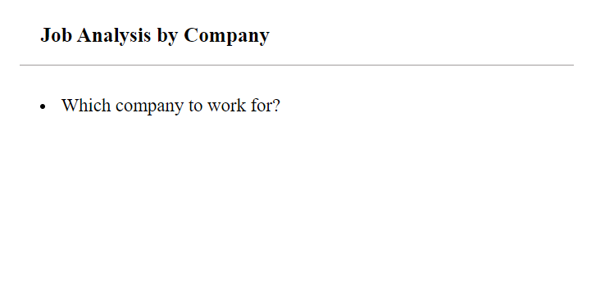

Slide 22
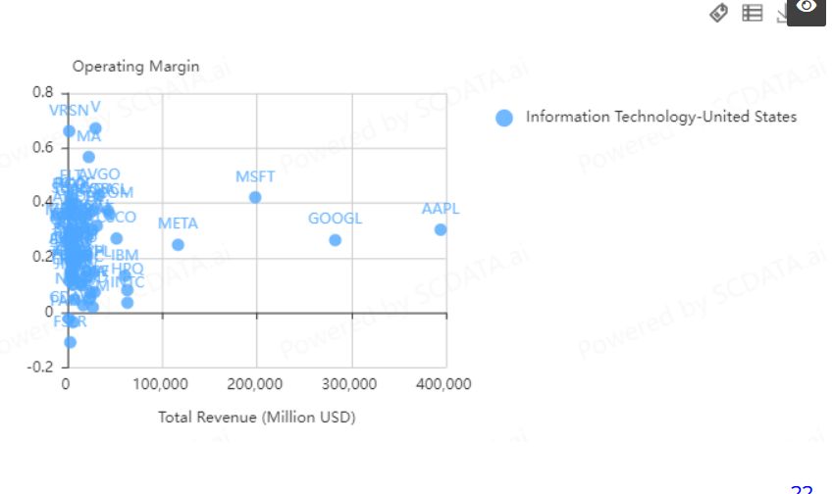

Slide 23
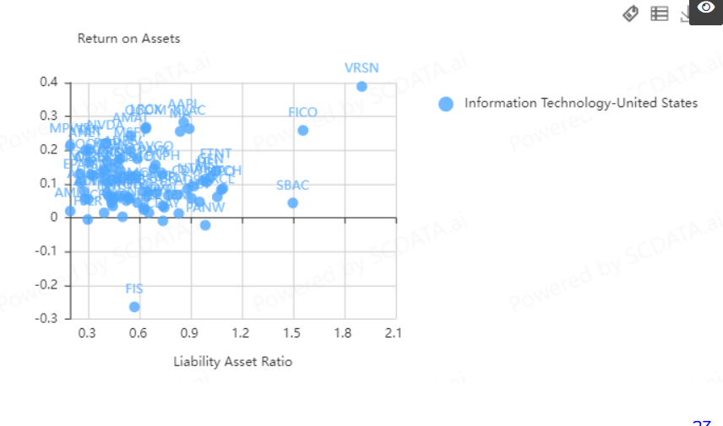

Slide 24
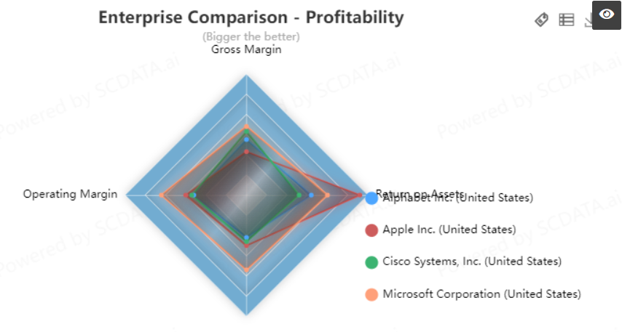

Slide 25
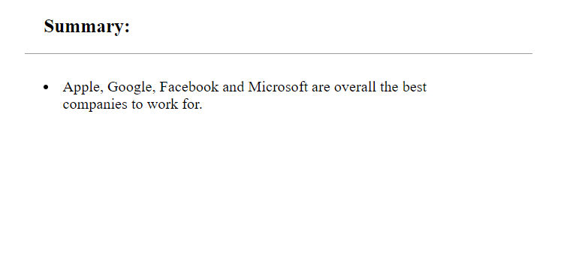

Slide 26
Conclusion:
By Region: Where to relocate.
California, New York and Texas are the best states to relocate for a job.
California, Texas and New York are also the highest states in terms of revenue.
In terms of total operating profit, California, Texas, New York, Illinois and Washington are the best states to relocate.
New York has the highest Total Liabilities.
California is the best state to work in Information Technology Sector.
Texas is the best state to work in Energy Sector.
New York is the best state to work in the Finance sector.
New York and New Jersey are best to relocate for healthcare jobs.
By Industry: Which Industry to join.
Information Technology Sector is the highest profitable sector.
Information Technology is the best sector for Operating Income as well.
IT firms are more profitable than Industrial firms.
IT firms grew faster in profit and revenue than Industrial firms.
Industrial firms have median liability asset ratio than IT firms.
By Enterprise: Which enterprise has highest job growth, better pay and job security.
Apple, Meta, Microsoft, Google are the best companies in terms of Operating Margin vs Revenue.
Among IT firms, VRSN, Apple, Fico, Qualcomm have the best Return on Assets vs. Liability Asset Ratio.

Slide 27
Conclusion
California is the best state to relocate overall.
Information Technology is the best sector to work for overall.
Apple is the best company to work for overall.

